Slide 1


Welcome To Food Recipe world

Slide 2



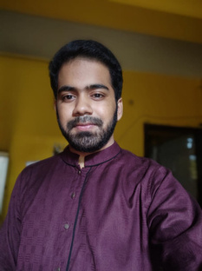
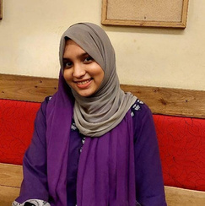
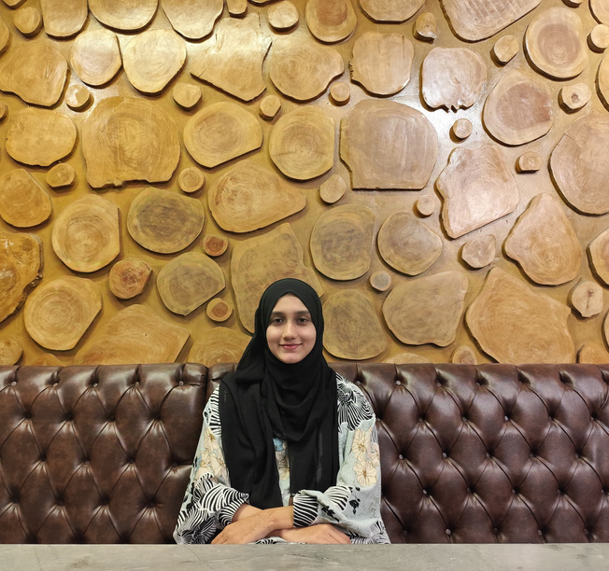
Meet Our Team
Ashab
Asir
Safayete
Nava
Ismita Sukkur
Tasin
ID-2244
ID-2235
ID-2228

Slide 3



Project Objective
1
2
Objective
Objective
To provide an accessible and user-friendly platform for individuals to explore, and discover a wide range of recipes.
To empower chefs by allowing them to share their culinary creations, manage their recipe portfolio, and engage with a growing community of food lovers.

Slide 4
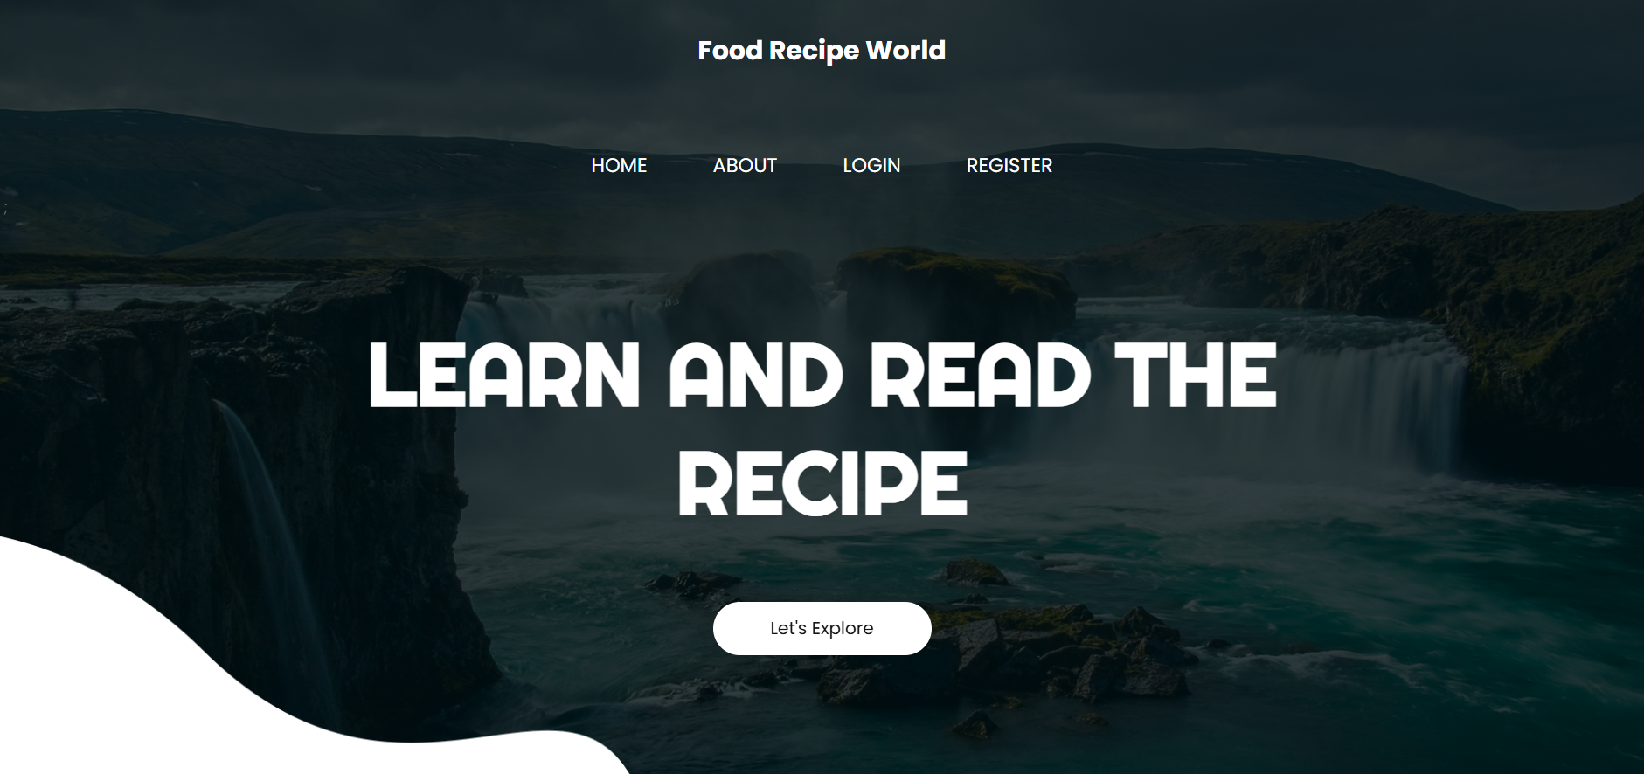

First Look

Slide 5


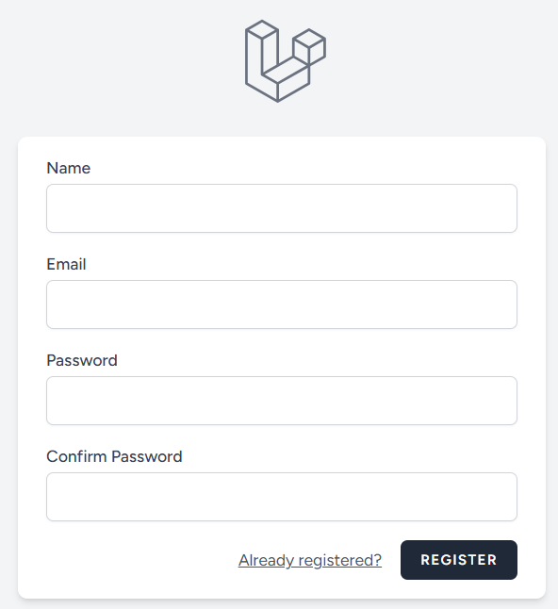
Signup pages
If a user or chef wants to signup the he/she have to click on signup button the pages looks like below

Slide 6
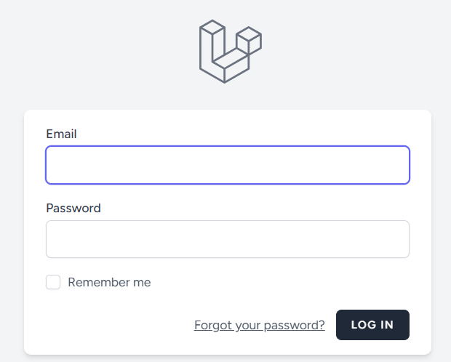
Login Page
If a user or chef have an account then they click login button and then login.Admin also can login. The page looks like given picture

Slide 7


After successfully login
We will see different UI for different panel
Chef/User
Admin
PANEL
PANEL

Slide 8
Chef/User Panel Start

Slide 9
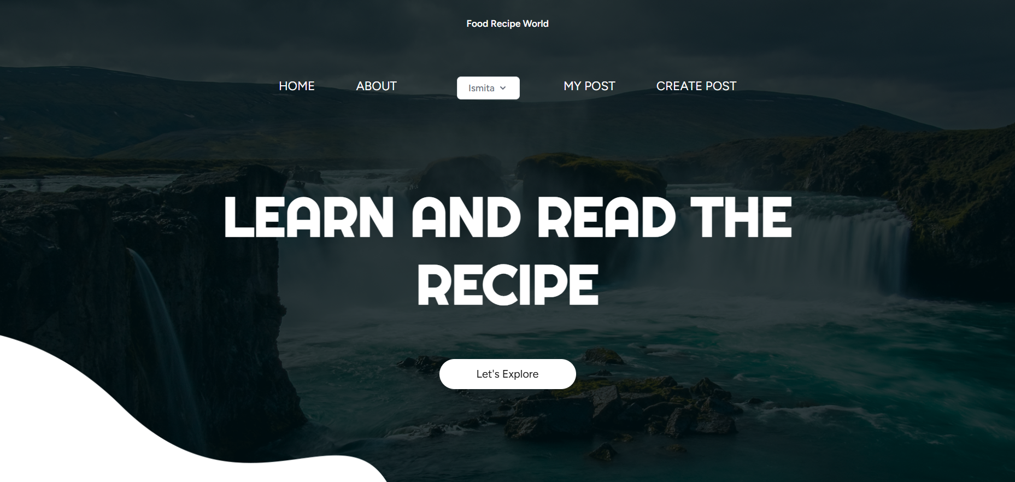
Chef home page
Here we will see in navbar home,about,user name,my post,create post.Then in body section he/she can see all the recipe posted by chefs

Slide 10

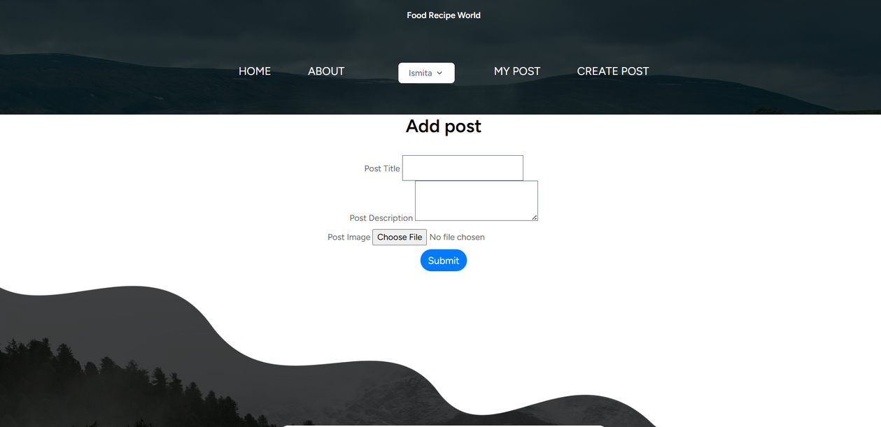

Chef/User create recipe page
In this recipe create page chef/user can create recipe by entering name,description and image of the recipe.

Slide 11
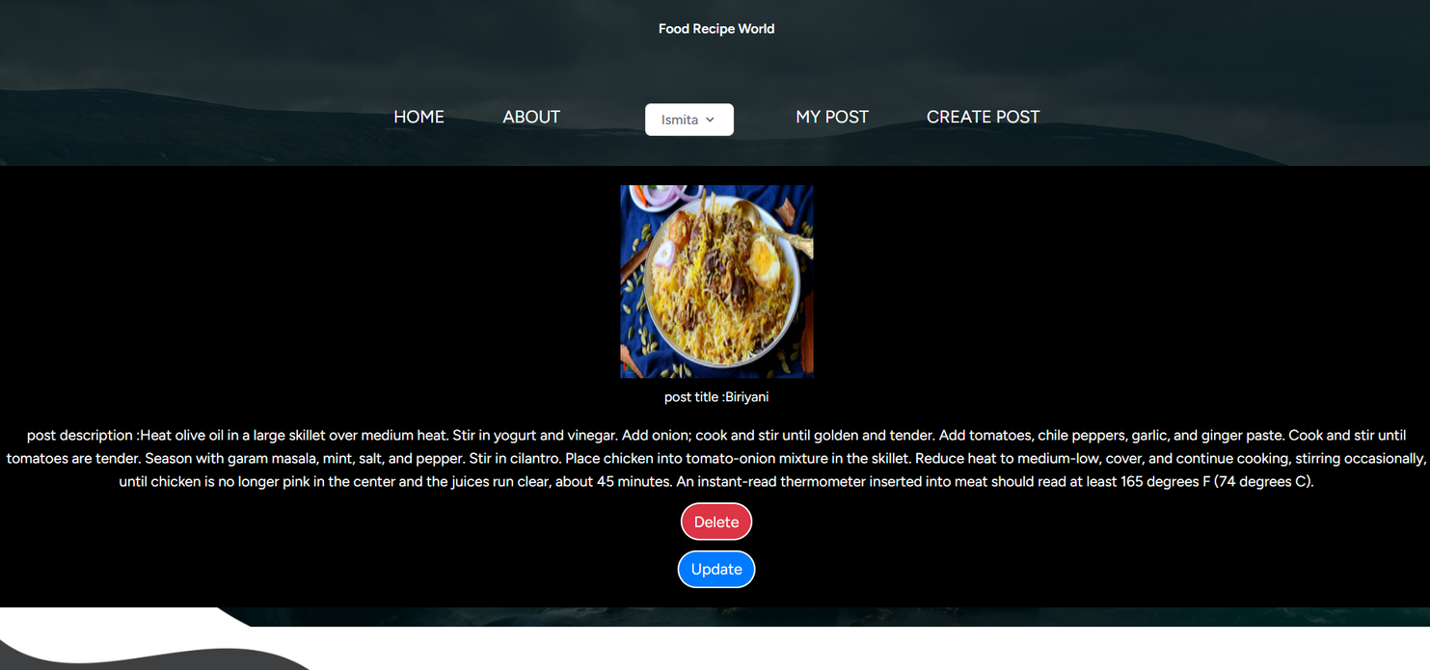

Manage recipe page
Here chef can update or delete his/her posted recipes

Slide 12
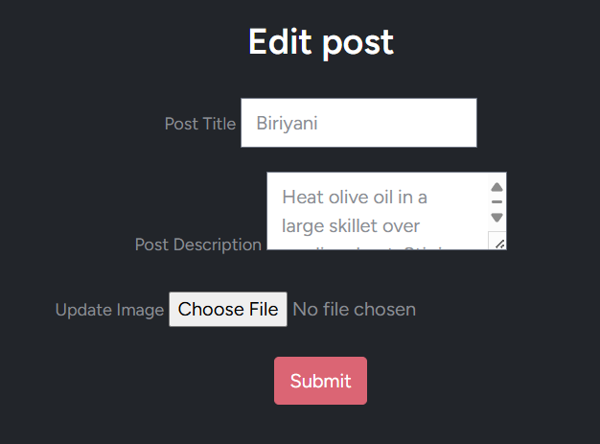
Chef update recipe page
Here chef can update his/her recipe

Slide 13
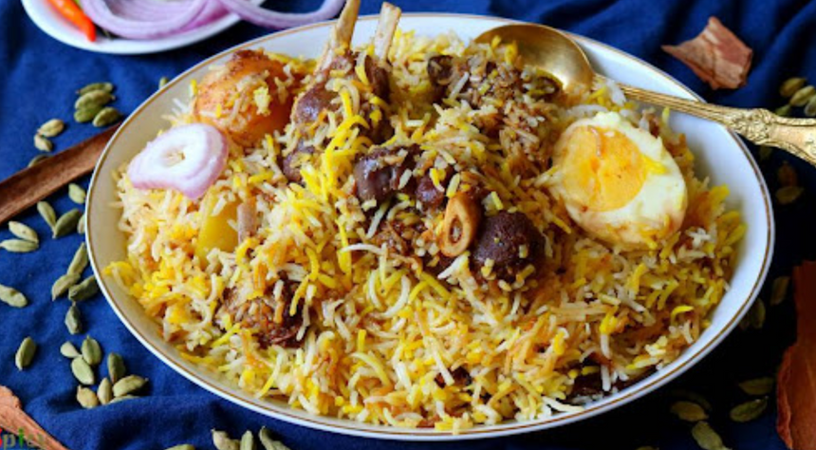
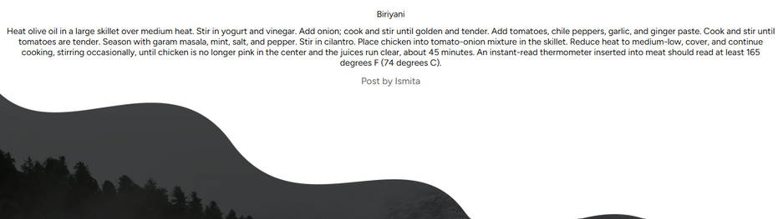
Chef recipe details page
here they can see the details of the recipe.

Slide 14
Admin Panel Start

Slide 15
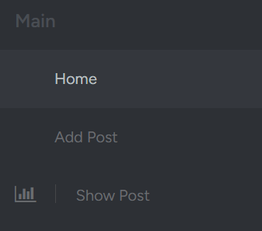
Admin home page
Here we will see in sidebar add post,show post,manage recipe tab.That means admin can see a post,add a post,manage a post.These are the main features of admin.

Slide 16
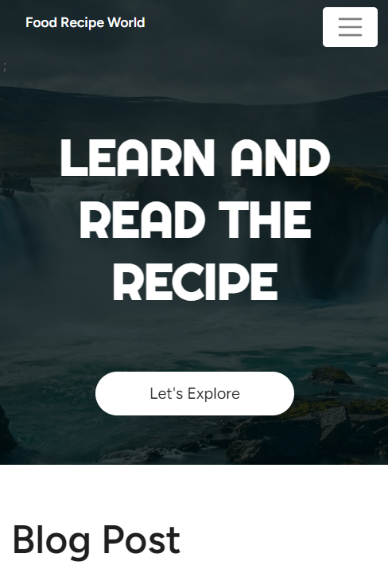
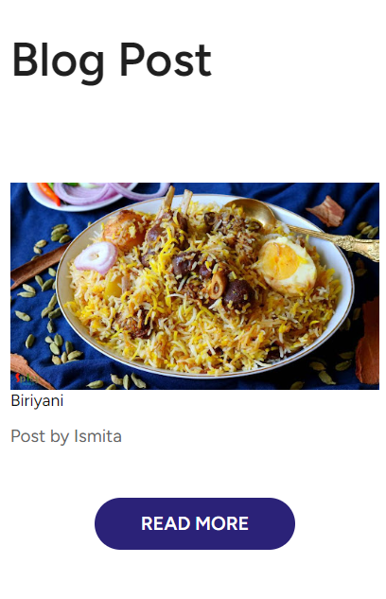
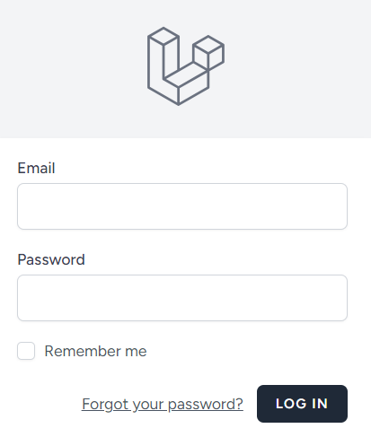
Fully Responsive Web Page

Slide 17
Roles
Frontend
Backend
Safayete Yesmin Nava: Design all the part for User panel
Ashab Asir: Handle the backend part ,and database related query and manupulation
Ismita Sukkur Tasin: Design all the part for admin panel

Slide 18
Thank You
Created By Asir, Nava & Tasin

